Slide 1
Operation Orchestration Authored Code Review Utility
Micro Focus Professional Services
Brought to you by Micro Focus Professional Services Global Delivery Center

Slide 2
Agenda
Code Review - Overview
Problem Statement.
OO Automated review – Data points.
Our Solution - Process Diagram
Our Solution - Technical Arch. Diagram
Features.
Technical Demo.
What's next?

Slide 3
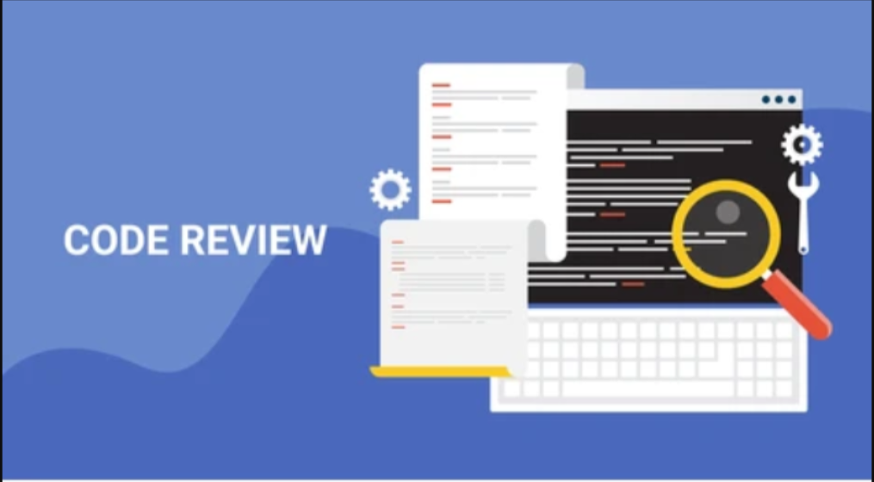
Code Review - Overview
What is Code Review?
The activity of checking another developer’s code for defects and improvement opportunities.
Checking code through a dedicated tool prior to merge upstream.
Validate coding style or standards.
Verify security features.
Checks for overall functionalities.

Slide 4

Why is it required?
What code review doesn't do?
Following are the requirements of using Code Review:
Reduced cost of Quality
Efficiency
Security
Improve Estimates
Code compliance
Code quality standardization
Self-evaluation
Better Accuracy and Productivity
Team management and reporting
Removing potential human error
Prevent bugs reaching production
It does not replace training
It does not replace demos

Slide 5
Why Do we Care about Code Review?
» Cost of Fixing Defects

Slide 6
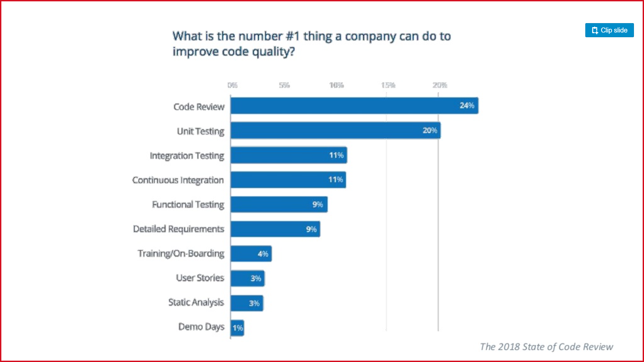
Why Do we Care about Code Review? Continued.

Slide 7
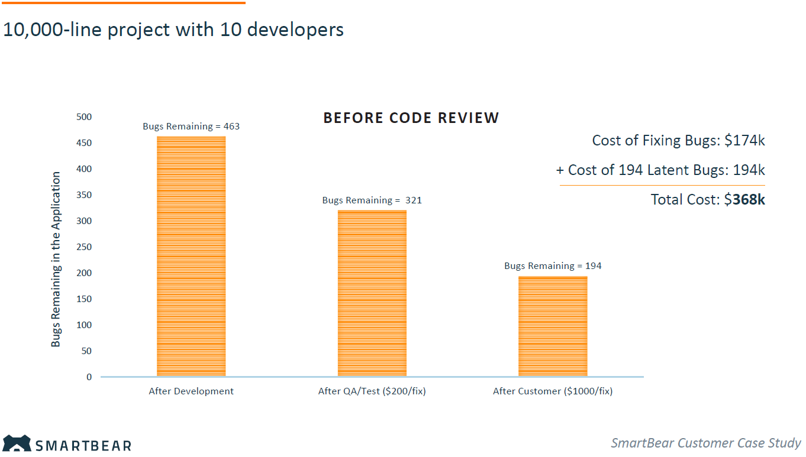
Why Do we Care about Code Review? Continued.
» SmartBear Customer Case Study

Slide 8
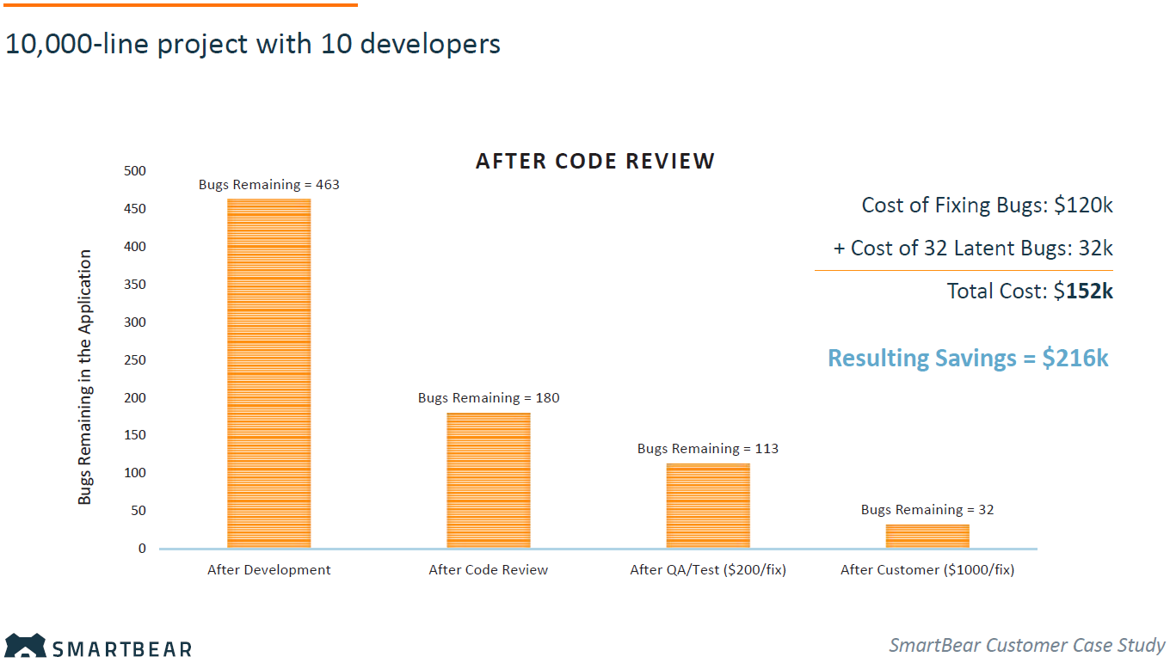
Why Do we Care about Code Review? Continued.
» SmartBear Customer Case Study

Slide 9
Types of Code Review.
Self Review
The developer himself reviews the code
Peer Review
Peers review each other’s code
Group Review
Team of reviewers does the review
Formal Code Review
Involves a careful and detailed process with multiple participants and multiple phases
Light Weight Code Review
Requires less overhead than formal code inspections
Can be equally effective when done properly

Slide 10




Problem Statement
During OO development developers may leave some issues (ex. using a constant value, prompt user) which does not satisfy the best practices of OO development.
Manual code review for finding these errors is challenging and time-consuming.
Sometimes this kind of issues has been skipped by eyes during review may cause in big failure in future.
Scenario:
Takes lot of time which user can not be utilize
Some of the errors can still be left
Code reviewer must prepare manual report
Manual code review for checking the errors is changing
Code reviewer must know all the errors that do not come under best practices
Solution: This utility will process all the flows, configuration items and system properties and will find out all the issues and warnings based on some violation rules(can be configured) and displays report in dashboard.
Solution is powered by using Python.
Business Outcome:
Reduced Effort
Better time optimization
Organized report
Reliable

Slide 11
Data about our automated review
Below are the key performance indicator from one of our existing project where utility is being used.
 | Number of Modules | No. of Defects | Defect Density | Invested Hours
Before Code Review Automation | 100 | 54 | 0.54 | 324
After Code Review Automation | 100 | 12 | 0.12 | 72
Hours Saved: 252
% Hours Saved: 78%
*Single module contains on an average 20 OO operations
*Estimated hours required to fix and test a defect is 6 Hrs.

Slide 12
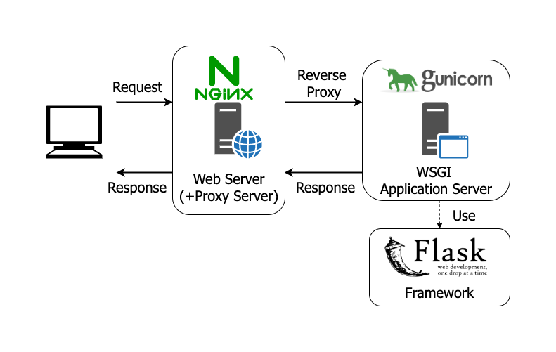


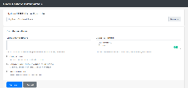



Our Solution - Technical Arch. Diagram(Backend)
Following is the technical architecture of our solution(Cod Review Automation Utility).
Client Web browser

Slide 13
Our Solution – Process Diagram
Following is the high-level process diagram of our solution(Cod Review Automation Utility).
Open Web URL and Upload Content Pack
Extract XML from Content Pack
Validate against Violation Matrix
Ignore Rules marked as Exception
Genrerate Report
Parse XML and retrieve objects

Slide 14
Solution Features
Organized & easy to use user interface - web application
Simple and organized dashboard.
Download report option - PDF , Excel.
Overall stats options – Error, Warnings, Flow count, System properties & accounts.
Rule configurable options.
Displays path and usages for system properties and accounts.
Validates error handling in scripts.
Color code – Issue(Red) & Warnings(Yellow).

Slide 15
Technical Demo

Slide 16
What's next??
Authentication: Authentication can be added to the utility so that each users workspace will be secured.
Results Storage: Results of each code review with reports can be stored by implementing Database in the architecture.
Feedback from other projects: Will take feedback from different projects of their needs, and if feasible will implement that.

Slide 17
Questions?

Slide 18
Thank You

Slide 19
Some stats about using code review automation
The advantages or the goals of code review are the following:
Finding bugs early, when they are cheap to fix.
Coding standards compliance. Code review helps to maintain consistent coding style across the company.
Teaching and sharing knowledge. During review team members gain better understanding of the code base and learn from each other.
Consistent design and implementation. Peer review helps to maintain a level of consistency in software design and implementation.
Higher software security. Applications that require a high level of security benefit from targeted security reviews.
Team cohesion. Review discussions save team members from isolation and bring them closer to each other.
Confidence of stakeholders. You build confidence of stakeholders about the technical quality of the execution.

